Slide 1
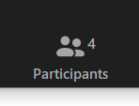
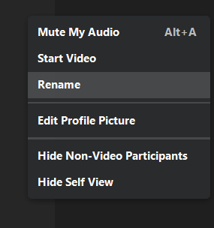
Think about which grade-level breakout room will work best for you today!
K, 1, 2, 3, 4, 5, 6, 7, 8, HS
Go to your participants icon to bring up the list of participants, find your name, and select More >Rename.
Or, hover over your image and rename yourself with your preferred grade-level and your name. For ex: 7 Allie Conway
For example: 8 Allie

Slide 2
Mathematically Connected Communities
This session will be recorded and available at https://mc2.nmsu.edu/
Welcome! Please introduce yourself in the chat box by writing your name, your district, and your role in the education sector.
Structuring Accelerated Learning in Reentry
September 9, 2020
5:00-6:00 pm

Slide 3
Mathematically Connected Communities (MC²) works to improve math education through a variety of professional learning experiences which align to the New Mexico Public Education Department’s (NM PED) reentry guidance.
Four Live Web-Events Sessions
Awareness and Information: Purposeful Reentry and Adapting to Change
Unpacking Important Mathematics Reentry Documents
Structuring Accelerated Learning in Reentry
The Importance of Models in Developing Fluency

Slide 4
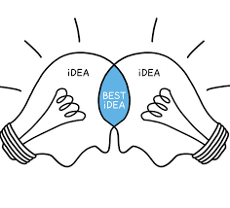
Norm Offerings for our Collaborative Session
In exploring today, what are the norm(s) you will take with you?
Invite participation by using names
Honor individual thinking and learning time
Ask questions
Expect to share
Reflect on where you want to grow
Other?

Slide 5
How are you feeling today?
Check In: https://student.desmos.com/join/h4cu4x

Slide 6
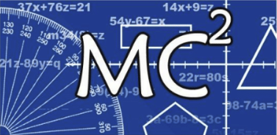
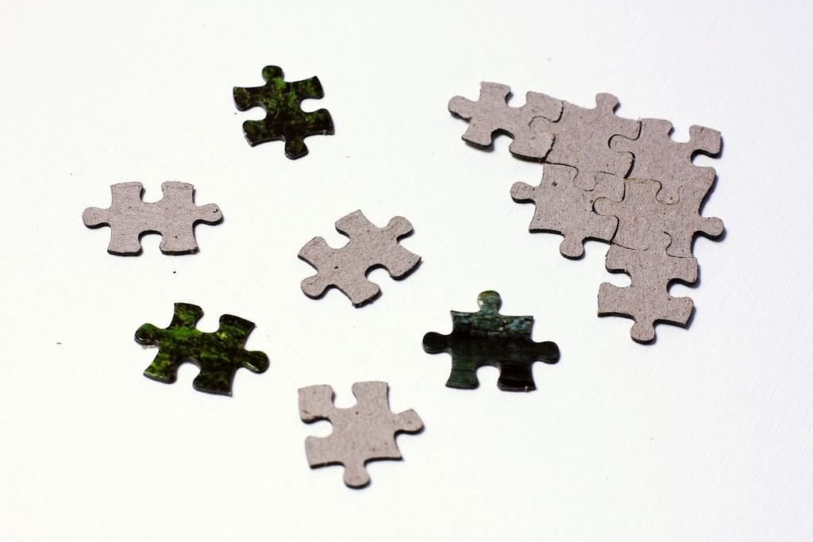
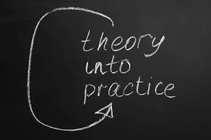
Session Goals
How do we structure our classroom for accelerated learning?
What are strategies for thoughtful acceleration?
What can I do right now?

Slide 7
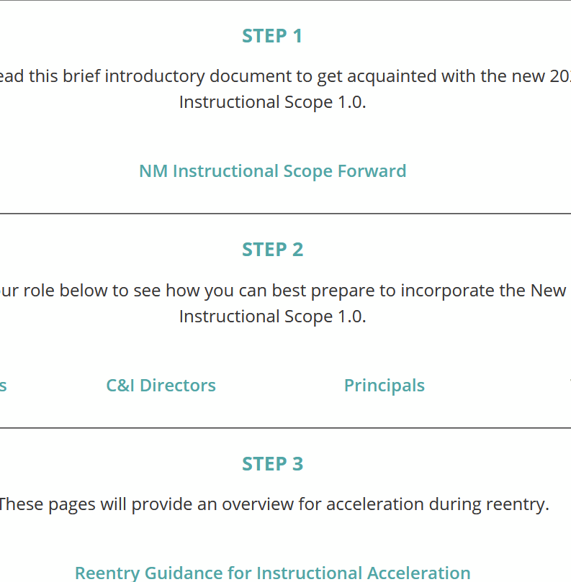
Small Group Explore
30 second brainstorm:
What do you already know about the priority documents?
In small groups, check in with what you already know and then take 10 minutes to explore again.
What do you still wonder/need to know about priority instructional content and/or acceleration?

Slide 8
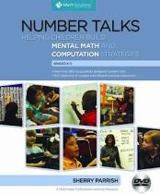
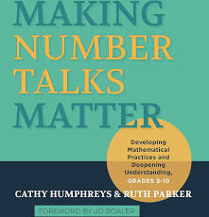
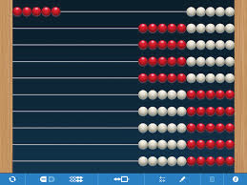
Number Talks
Jamboard Reflection: https://jamboard.google.com/d/1nLD5Ve9YWU24RjueJ3lK2xharuY04nwhs2KLpM0j8q4/edit?usp=sharing

Slide 9
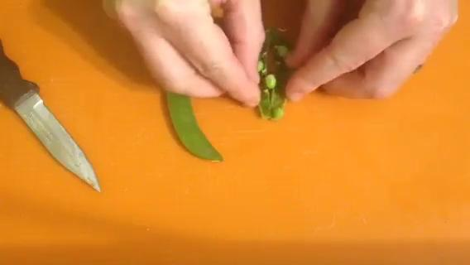
Act 1, Peas in a Pod

Slide 10
Act 1, Peas in a Pod
What do you wonder?
In the chat, estimate how many peas are in each pod: Large, medium, and small.
If all the peas were in one pod, how many peas would there be?
Make an estimate you know is too big. Too small.

Slide 11
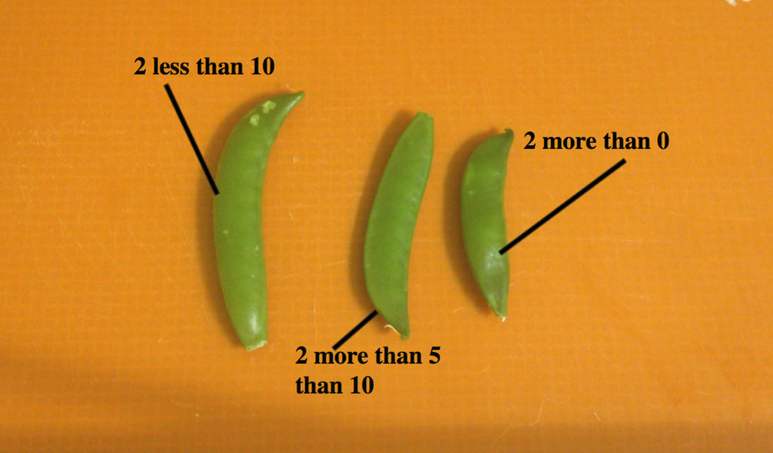
Act 2: Need more information? Try this!

Slide 12
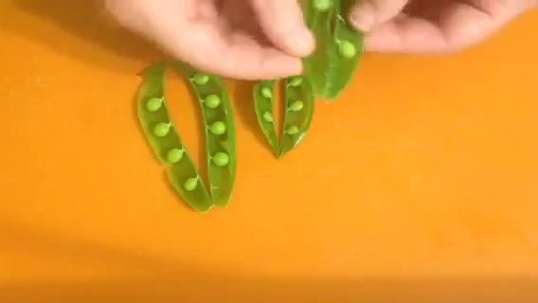
Act 3: Peas in a Pod
https://gfletchy.com/peas-in-a-pod/

Slide 13
Session Goals
How do we structure our classroom for accelerated learning?
What are strategies for thoughtful acceleration?
What can I do right now?

Slide 14
Reflect: What do you know now that you would share with a colleague? What have you learned that excites you about planning for students’ mathematics learning?

Slide 15
Thank you!
How to Register for Web Sessions
Register in learning pairs through the MC² website
Registration will open the Thursday before the event
Events will start at 5:00 pm unless otherwise noted on the registration form
Link to MC² Website:
https://mc2.nmsu.edu/
Link to MC² Professional Learning Webpage: https://mc2.nmsu.edu/pd/
Link to MC² Contact Page: https://mc2.nmsu.edu/about-us/contact-us/
Mark your calendars:
September 9
September 23

